Slide 1
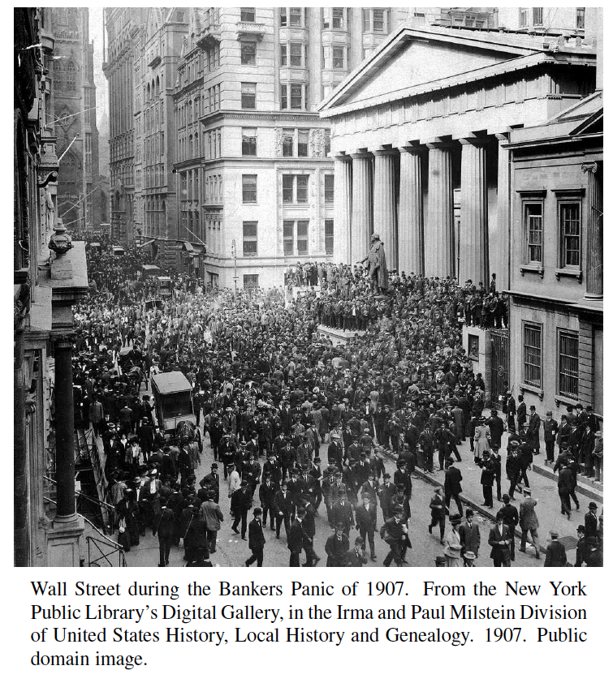
Priority Queues
Presentation for use with the textbook Algorithm Design and Applications, by M. T. Goodrich and R. Tamassia, Wiley, 2015

Slide 2
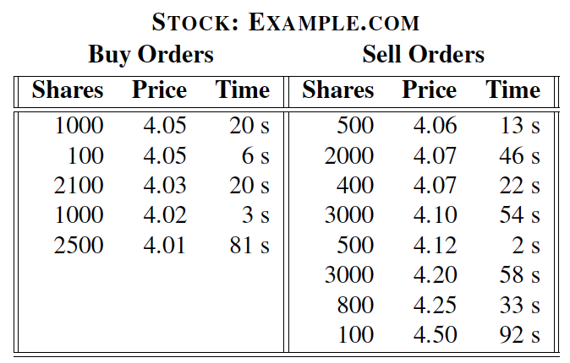
Application: Stock Matching Engines
At the heart of modern stock trading systems are highly reliable systems known as matching engines, which match the stock trades of buyers and sellers.
A simplification of how such a system works is in terms of a continuous limit order book, where buyers post bids to buy a number of shares in a given stock at or below a specified price and sellers post offers to sell a number of shares of a given stock at or above a specified price.

Slide 3
Application: Stock Matching Engines
Buy and sell orders are organized according to a price-time priority:
“price” has highest priority and if there are multiple orders for the same price, then ones that have been in the order book the longest have higher priority.
When a new order is entered, the matching engine determines if a trade can be immediately executed and if so, then it performs the appropriate matches according to price-time priority.
This amount to two instances of the data structure we discuss here—the priority queue—one for buy orders and one for sell orders.
This data structure performs element removals based on priorities assigned to elements when they are inserted.
Sell orders
Matching
Engine
Buy orders

Slide 4
Total Order Relations
Keys in a priority queue can be arbitrary objects on which an order is defined
Every pair of such keys must be comparable according to a total order.
Mathematical concept of total order relation ≤
Comparability property: either x ≤ y or y ≤ x
Reflexive property: x ≤ x
Antisymmetric property: x ≤ y and y ≤ x ⇒ x = y
Transitive property: x ≤ y and y ≤ z ⇒ x ≤ z
So there is a notion of smallest key k ≤ any other key in total order.
Total order defines a linear ordering relationship.

Slide 5
Priority Queue Operations
A priority queue stores a collection of entries
Each entry is a pair (key, value)
Main methods:
insert(k, v) inserts an entry with key k and value v
removeMin() removes and returns the entry with smallest key, or null if the the priority queue is empty
Additional methods:
min() returns, but does not remove, an entry with smallest key, or null if the the priority queue is empty
size(), isEmpty()
Applications:
Standby flight passengers
Auctions
Stock markets

Slide 6
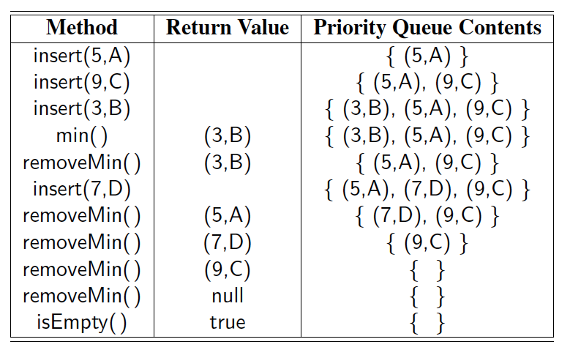
Example
A sequence of priority queue methods:

Slide 7
List-based Priority Queues
Implementation with an unsorted list
Performance:
insert takes O(1) time since we can insert the item at the beginning or end of the sequence
removeMin and min take O(n) time since we have to traverse the entire sequence to find the smallest key
Implementation with a sorted list
Performance:
insert takes O(n) time since we have to find the place where to insert the item
removeMin and min take O(1) time, since the smallest key is at the beginning
4
5
2
3
1
1
2
3
4
5

Slide 8
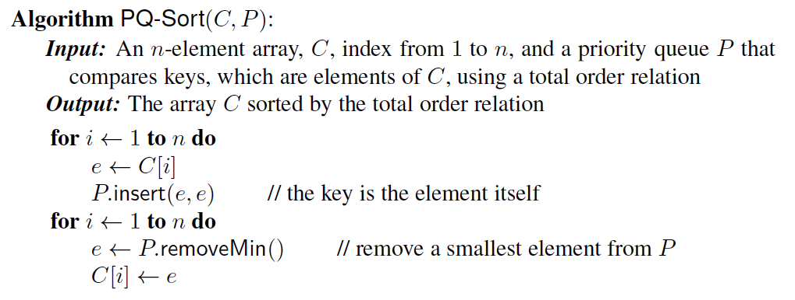
Priority Queue Sorting
We can use a priority queue to sort a list of comparable elements
Insert the elements one by one with a series of insert operations
Remove the elements in sorted order with a series of removeMin operations
The running time of this sorting method depends on the priority queue implementation.

Slide 9
Selection-Sort
Selection-sort is the variation of PQ-sort where the priority queue is implemented with an unsorted sequence
Running time of Selection-sort:
Inserting the elements into the priority queue with n insert operations takes O(n) time
Removing the elements in sorted order from the priority queue with n removeMin operations takes time proportional to 1 + 2 + …+ n
Selection-sort runs in O(n²) time

Slide 10
Selection-Sort Example
Sequence S Priority Queue P
Input: (7,4,8,2,5,3,9) ()
Phase 1
(a) (4,8,2,5,3,9) (7)
(b) (8,2,5,3,9) (7,4)
.. .. ..
(g) () (7,4,8,2,5,3,9)
Phase 2
(a) (2) (7,4,8,5,3,9)
(b) (2,3) (7,4,8,5,9)
(c) (2,3,4) (7,8,5,9)
(d) (2,3,4,5) (7,8,9)
(e) (2,3,4,5,7) (8,9)
(f) (2,3,4,5,7,8) (9)
(g) (2,3,4,5,7,8,9) ()

Slide 11
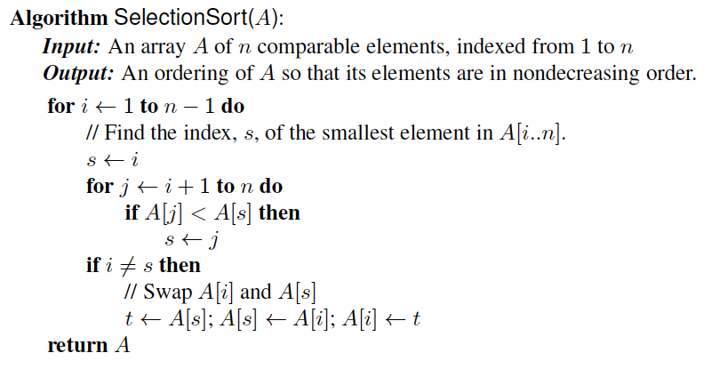
In-place Selection Sort
A sorting algorithm is in-place if it uses only a small amount of memory in addition to the input array itself.

Slide 12
Insertion-Sort
Insertion-sort is the variation of PQ-sort where the priority queue is implemented with a sorted sequence
Running time of Insertion-sort:
Inserting the elements into the priority queue with n insert operations takes time proportional to
1 + 2 + …+ n
Removing the elements in sorted order from the priority queue with a series of n removeMin operations takes O(n) time
Insertion-sort runs in O(n²) time in the worst case.

Slide 13
Insertion-Sort Example
Sequence S Priority queue P
Input: (7,4,8,2,5,3,9) ()
Phase 1
(a) (4,8,2,5,3,9) (7)
(b) (8,2,5,3,9) (4,7)
(c) (2,5,3,9) (4,7,8)
(d) (5,3,9) (2,4,7,8)
(e) (3,9) (2,4,5,7,8)
(f) (9) (2,3,4,5,7,8)
(g) () (2,3,4,5,7,8,9)
Phase 2
(a) (2) (3,4,5,7,8,9)
(b) (2,3) (4,5,7,8,9)
.. .. ..
(g) (2,3,4,5,7,8,9) ()

Slide 14
In-place Insertion-Sort
Instead of using an external data structure, we can implement selection-sort and insertion-sort in-place
A portion of the input sequence itself serves as the priority queue
For in-place insertion-sort
We keep sorted the initial portion of the sequence
We can use swaps instead of modifying the sequence
5
4
2
3
1
5
4
2
3
1
4
5
2
3
1
2
4
5
3
1
2
3
4
5
1
1
2
3
4
5
1
2
3
4
5

Slide 15
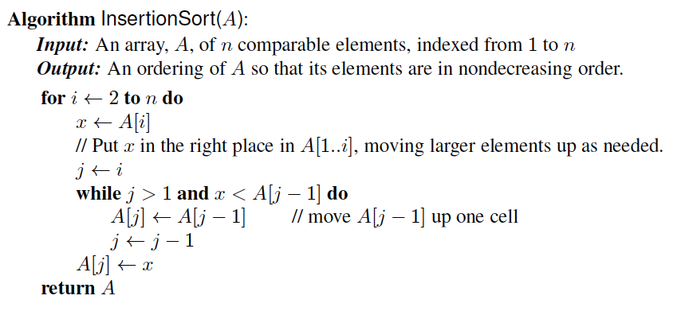
In-Place Insertion-Sort
Pseudo-code:

Slide 16
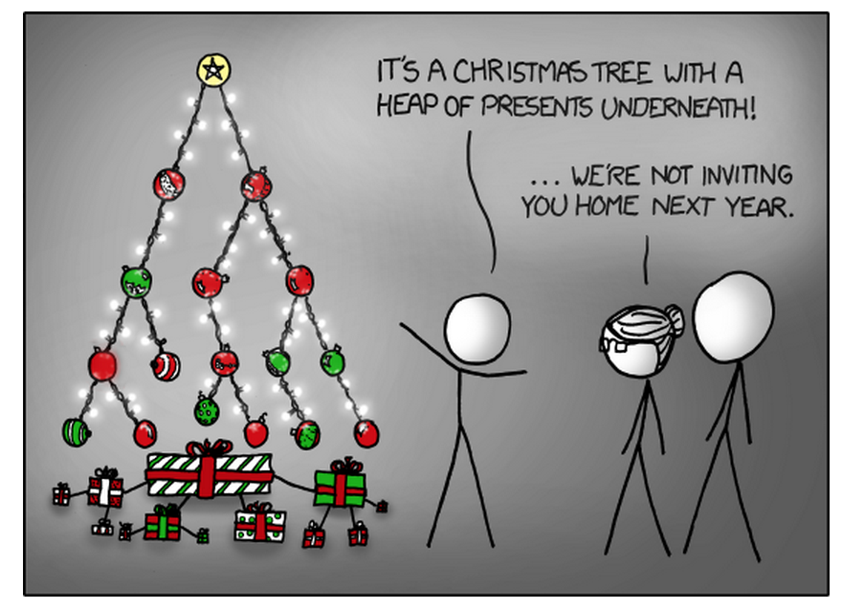
Heaps
Presentation for use with the textbook Algorithm Design and Applications, by M. T. Goodrich and R. Tamassia, Wiley, 2015
xkcd. http://xkcd.com/835/. “Tree.” Used with permission under Creative Commons 2.5 License.

Slide 17
Recall Priority Queue Operations
A priority queue stores a collection of entries
Each entry is a pair (key, value)
Main methods of the Priority Queue ADT
insert(k, v) inserts an entry with key k and value v
removeMin() removes and returns the entry with smallest key
Additional methods
min() returns, but does not remove, an entry with smallest key
size(), isEmpty()
Applications:
Standby flyers
Auctions
Stock market engines

Slide 18
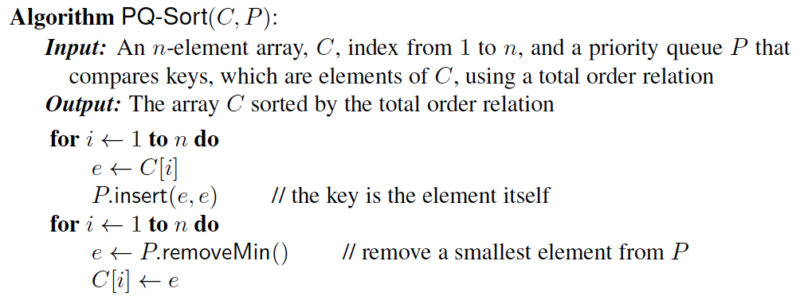

Recall PQ Sorting
We use a priority queue
Insert the elements with a series of insert operations
Remove the elements in sorted order with a series of removeMin operations
The running time depends on the priority queue implementation:
Unsorted sequence gives selection-sort: O(n²) time
Sorted sequence gives insertion-sort: O(n²) time
Can we do better?

Slide 19
Heaps
A heap is a binary tree storing keys at its nodes and satisfying the following three properties:
Heap-Order: for every internal node v other than the root, key(v) ≥ key(parent(v))
Complete Binary Tree: let h be the height of the heap
for i = 0, … , h − 1, there are 2^{i} nodes of depth i
at depth h − 1, the internal nodes are to the left of the external nodes
The last node of a heap is the rightmost node of maximum depth
2
5
6
9
7
last node

Slide 20
Height of a Heap
Theorem: A heap storing n keys has height O(log n)
Proof: (we apply the complete binary tree property)
Let h be the height of a heap storing n keys
Since there are 2^{i} keys at depth i = 0, … , h − 1 and at least one key at depth h, we have n ≥ 1 + 2 + 4 + … + 2^{h−1} + 1
Thus, n ≥ 2^{h} , i.e., h ≤ log n
depth
keys
0
1
1
2
h−1
2^{h−1}
h
1

Slide 21
Heaps and Priority Queues
We can use a heap to implement a priority queue
We store a (key, element) item at each internal node
We keep track of the position of the last node
(2, Sue)
(5, Pat)
(6, Mark)
(9, Jeff)
(7, Anna)

Slide 22
Array-based Heap Implementation
We can represent a heap with n keys by means of an array of length n
For the node at rank i
the left child is at rank 2i
the right child is at rank 2i + 1
Links between nodes are not explicitly stored
Operation add corresponds to inserting at rank n + 1
Operation remove_min corresponds to removing at rank n
Yields in-place heap-sort
2
5
6
9
7
2
5
6
9
7
1
2
3
4
5

Slide 23
Insertion into a Heap
Method insertItem of the priority queue ADT corresponds to the insertion of a key k to the heap
The insertion algorithm consists of three steps
Find the insertion node z (the new last node)
Store k at z
Restore the heap-order property (discussed next)
2
5
z
6
9
7
insertion node
2
5
6
z
9
7
1

Slide 24
Upheap
After the insertion of a new key k, the heap-order property may be violated
Algorithm upheap restores the heap-order property by swapping k along an upward path from the insertion node
Upheap terminates when the key k reaches the root or a node whose parent has a key smaller than or equal to k
Since a heap has height O(log n), upheap runs in O(log n) time
2
1
5
1
5
2
z
z
9
7
6
9
7
6

Slide 25
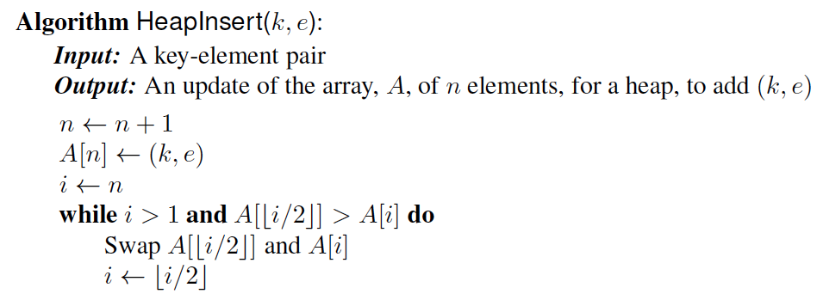
Insertion Pseudo-Code
Assumes an array-based heap implementation.

Slide 26
Removal from a Heap
Method removeMin of the priority queue ADT corresponds to the removal of the root key from the heap
The removal algorithm consists of three steps
Replace the root key with the key of the last node w
Remove w
Restore the heap-order property (discussed next)
2
5
6
w
9
7
last node
7
5
w
6
9
new last node

Slide 27
Downheap
After replacing the root key with the key k of the last node, the heap-order property may be violated
Algorithm downheap restores the heap-order property by swapping key k along a downward path from the root
Downheap terminates when key k reaches a leaf or a node whose children have keys greater than or equal to k
Since a heap has height O(log n), Downheap runs in O(log n) time
7
5
5
w
6
7
w
6
9
9

Slide 28
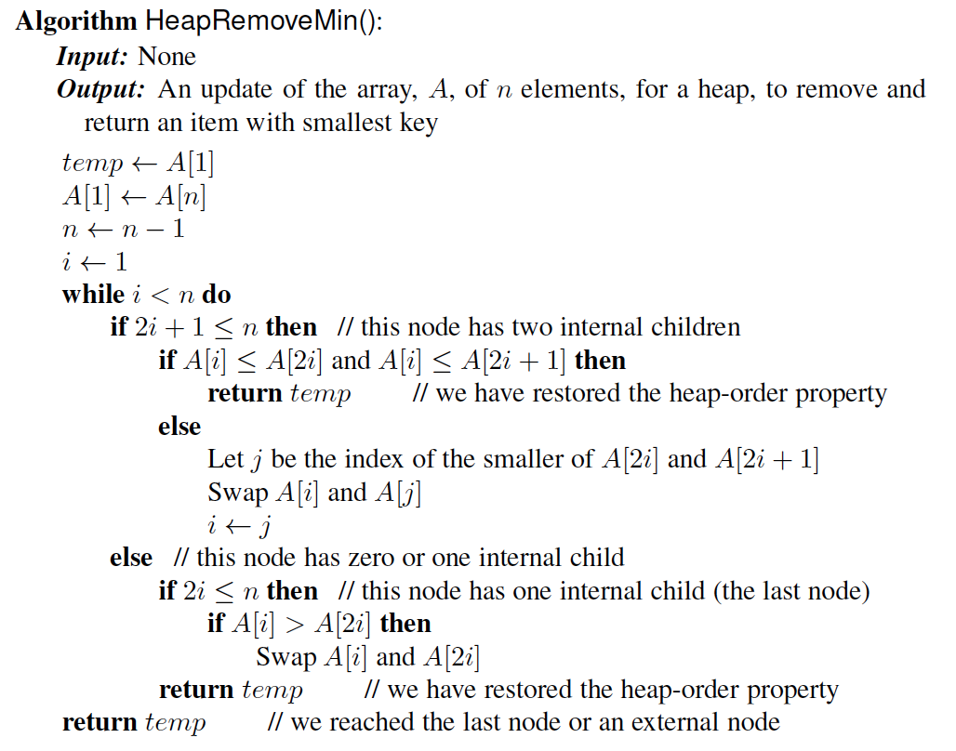
RemoveMin Pseudo-code
Assumes heap is implemented with an array.

Slide 29
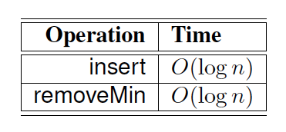
Performance of a Heap
A heap has the following performance for the priority queue operations.
The above analysis is based on the following facts:
The height of heap T is O(log n), since T is complete.
In the worst case, up-heap and down-heap bubbling take time proportional to the height of T.
Finding the insertion position in the execution of insert and updating the last node position in the execution of removeMin takes constant time.
The heap T has n internal nodes, each storing a reference to a key and a reference to an element.

Slide 30
Heap-Sort
Consider a priority queue with n items implemented by means of a heap
the space used is O(n)
methods insert and removeMin take O(log n) time
methods size, isEmpty, and min take time O(1) time
Using a heap-based priority queue, we can sort a sequence of n elements in O(n log n) time
The resulting algorithm is called heap-sort
Heap-sort is much faster than quadratic sorting algorithms, such as insertion-sort and selection-sort

Slide 31
Merging Two Heaps
We are given two heaps and a key k
We create a new heap with the root node storing k and with the two heaps as subtrees
We perform downheap to restore the heap-order property
3
2
8
5
4
6
7
3
2
8
5
4
6
2
3
4
8
5
7
6

Slide 32
Bottom-up Heap Construction
We can construct a heap storing n given keys in using a bottom-up construction with log n phases
In phase i, pairs of heaps with 2^{i} −1 keys are merged into heaps with 2^{i+1}−1 keys
2^{i} −1
2^{i} −1
2^{i+1}−1

Slide 33
Example
16
15
4
12
6
7
23
20
25
5
11
27
16
15
4
12
6
7
23
20

Slide 34
Example (contd.)
25
5
11
27
16
15
4
12
6
9
23
20
15
4
6
23
16
25
5
12
11
9
27
20

Slide 35
Example (contd.)
7
8
15
4
6
23
16
25
5
12
11
9
27
20
4
6
15
5
8
23
16
25
7
12
11
9
27
20

Slide 36
Example (end)
10
4
6
15
5
8
23
16
25
7
12
11
9
27
20
4
5
6
15
7
8
23
16
25
10
12
11
9
27
20

Slide 37
Analysis
We visualize the worst-case time of a downheap with a proxy path that goes first right and then repeatedly goes left until the bottom of the heap (this path may differ from the actual downheap path)
Since each node is traversed by at most two proxy paths, the total number of nodes of the proxy paths is O(n)
Thus, bottom-up heap construction runs in O(n) time
Bottom-up heap construction is faster than n successive insertions and speeds up the first phase of heap-sort, which takes O(n log n) time in its second phase.

Slide 38
Extending Priority Queues
Presentation for use with the textbook Algorithm Design and Applications, by M. T. Goodrich and R. Tamassia, Wiley, 2015
3
a
5
g
4
e

Slide 39
Entries Locator and Priority Queues
An entry stores a (key, value) pair
Locator maintains the position of (k,v).
Locator L methods:
key(): returns the key of the item associated with with locator L
element(): returns the the element paired of the item associated with locator L
Priority Queue ADT:
insert(k, x) inserts an entry with key k and value x
removeMin() removes and returns the entry with smallest key
min() returns, but does not remove, an entry with smallest key
size(), isEmpty()

Slide 40

Stock Application Revisited
Online trading system where orders to purchase and sell a stock are stored in two priority queues (one for sell orders and one for buy orders) as (p,s) entries:
The key, p, of an order is the price
The value, s, for an entry is the number of shares
A buy order (p,s) is executed when a sell order (p’,s’) with price p’<p is added (the execution is complete if s’>s)
A sell order (p,s) is executed when a buy order (p’,s’) with price p’>p is added (the execution is complete if s’>s)
What if someone wishes to cancel their order before it executes?
What if someone wishes to update the price or number of shares for their order?

Slide 41
Locator-based Priority Queue Methods
min(): Return the locator to an item of P with smallest key
insert(k,e): Insert a new item with element e and key k and return a locator to the item
remove(L): Remove from P the item with locator L
replaceKey(L,k): Replace with k and return the key of the item with locator L
an error condition occurs if k is invalid (that is, k cannot be compared with other keys).
replaceElement(L,e): Replace with e and return the element of the item with locator L

Slide 42
Example
Operation Output P
insert(5,A) L₁ (5,A)
insert(3,B) L₂ (3,B),(5,A)
insert(7,C) L₃ (3,B),(5,A),(7,C)
min() L₂ (3,B),(5,A),(7,C)
key(L₂) 3 (3,B),(5,A),(7,C)
remove(L₁) (3,B),(7,C)
replaceKey(L₂ 9) 3 (7,C),(9,B)
replaceElement(L₃,D) C (7,D),(9,B)
remove(L₂) (7, D)

Slide 43
Locating Entries
In order to implement the operations remove(e), replaceKey(e,k), and replaceElement(e,v), we need fast ways of locating an entry e in a priority queue.
We can always just search the entire data structure to find an entry e, but there are better ways for locating entries.

Slide 44
Location-Aware Entries
A location-aware entry (locator) identifies and tracks the location of its (key, value) object within a data structure
Intuitive notion:
Coat claim check
Valet claim ticket
Reservation number
Main idea:
Since entries are created and returned from the data structure itself, it can return location-aware entries, thereby making future updates easier

Slide 45
List Implementation
A location-aware list entry is an object storing
key
value
position (or rank) of the item in the list
In turn, the position (or array cell) stores the entry
Back pointers (or ranks) are updated during swaps
header
nodes/positions
trailer
2
c
4
c
5
c
8
c
entries

Slide 46
Heap Implementation
A location-aware heap entry is an object storing
key
value
position of the entry in the underlying heap
In turn, each heap position stores an entry
Back pointers are updated during entry swaps
2
d
4
a
6
b
8
g
5
e
9
c

Slide 47
Performance
Improved times thanks to location-aware entries are highlighted in red
Method Unsorted List Sorted List Heap
size, isEmpty O(1) O(1) O(1)
insert O(1) O(n) O(log n)
min O(n) O(1) O(1)
removeMin O(n) O(1) O(log n)
remove O(1) O(1) O(log n)
replaceKey O(1) O(n) O(log n)
replaceValue O(1) O(1) O(1)

Slide 48
Positions vs. Locators
Position
Represents a “place” in a data structure
Related to other positions in the data structure (e.g., previous/next or parent/child)
Implemented as a node or an array cell
Position-based ADTs (e.g.,
sequence and tree) are
fundamental data storage
schemes
Locator
Identifies and tracks a (key,
element) item
Unrelated to other locators in the data structure implemented as an object storing the item and its position in the underlying structure
Key-based ADTs (e.g., priority queue and dictionary) can be augmented with locator-based methods

